Slide 1
PROJECT MENGANALISIS DATABASES SQL
STUDY INDEPENDEN
NIGRASIP
KELAS : 13

Slide 2
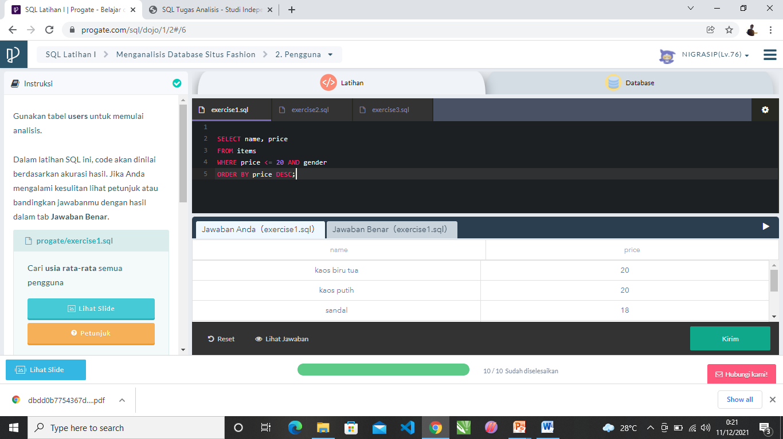
LATIAN 1

Slide 3
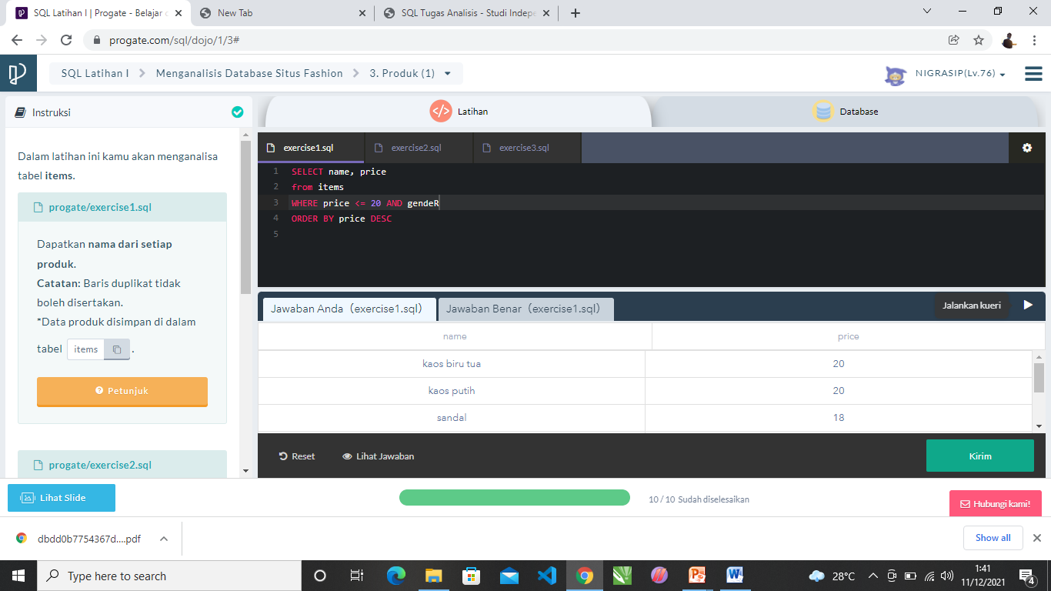
LATIAN 2

Slide 4
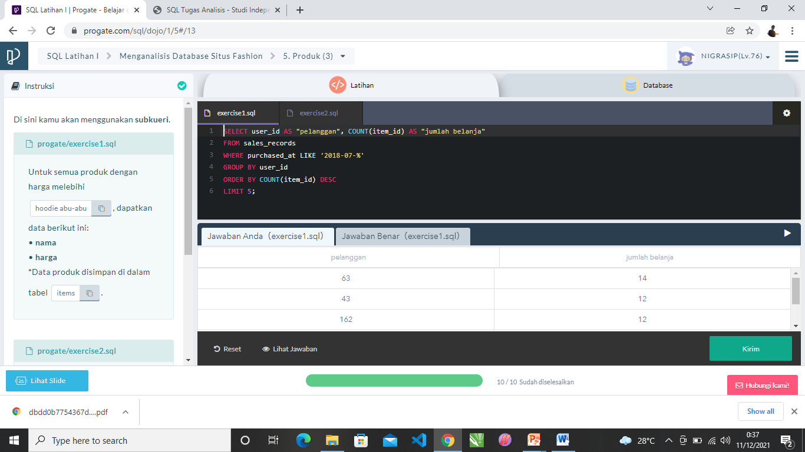
LATIAN 3

Slide 5
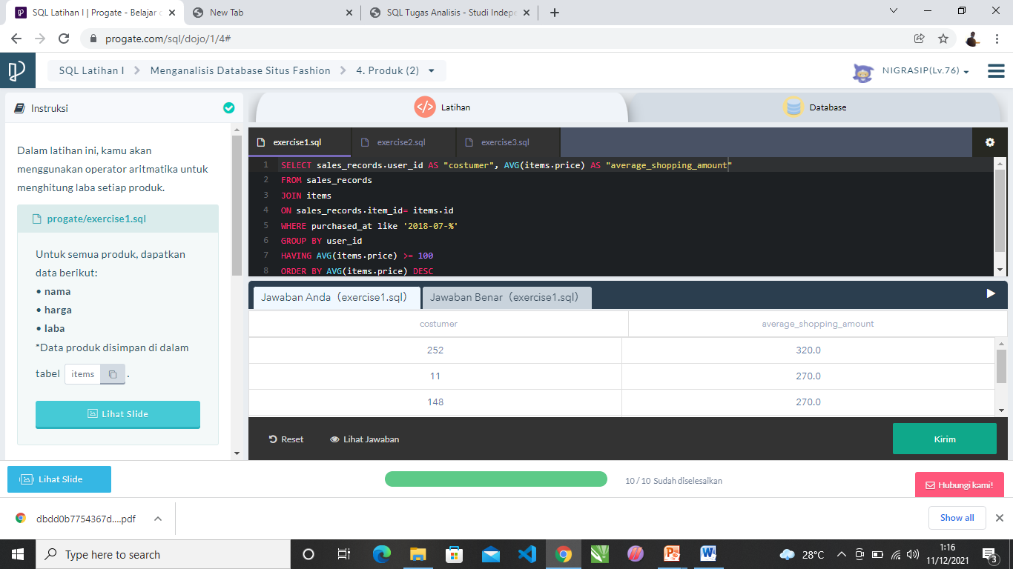
LATIAN 4

Slide 6
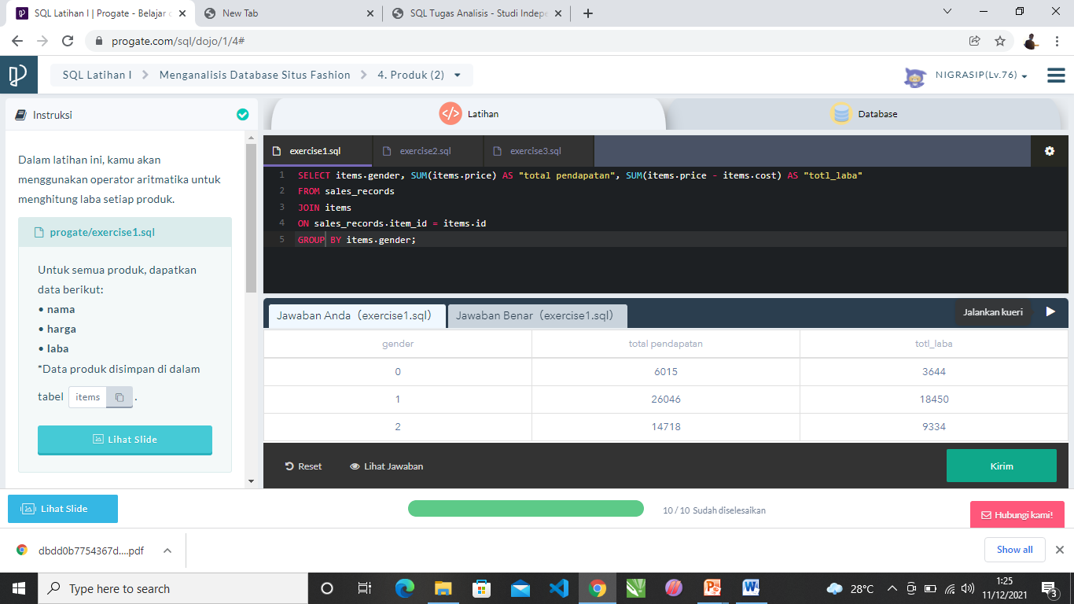
LATIAN 5

Slide 7
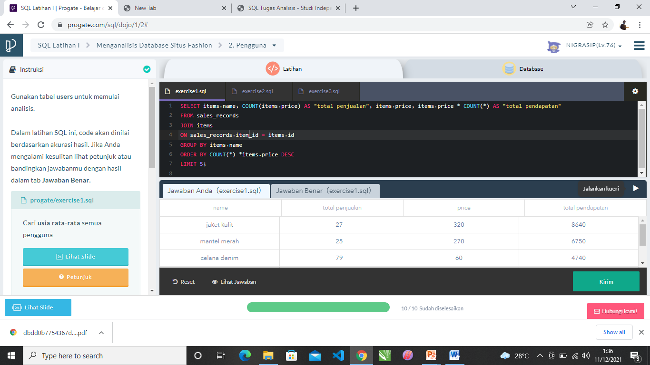
LATIAN 6

